Slide 1


Real-estate Investment in Toronto
Qian Song
For IBM Data Science Capstone
Oct, 2019

Slide 2
Introduction
Joe has been investing in Canadian real-estate for many years, and recently he noticed that apartments locating near Chinese restaurants and Chinese grocery stores are becoming more popular among tenants. Therefore, 3 requirements were identified as:
With Chinese grocery stores nearby
With Chinese restaurants nearby
Better with a mall or city-center environment

Slide 3
Data Description
Data Scraping
Raw data were scraped from wikipedia (https://en.wikipedia.org/wiki/List_of_postal_codes_of_Canada:_M) which were later cleaned and transformed into pandas data-frame for better analysis.
Location Analysis
The main location source used in the analysis is Foursquare, which provide the neighborhood information of venue, service categories, location, ratings and tips.

Slide 4
Methodology
K-means clustering was applied to find the location similar to city centers and malls, while the other two requirements were solved by the venue and ratings information gained from Foursquare API.

Slide 5
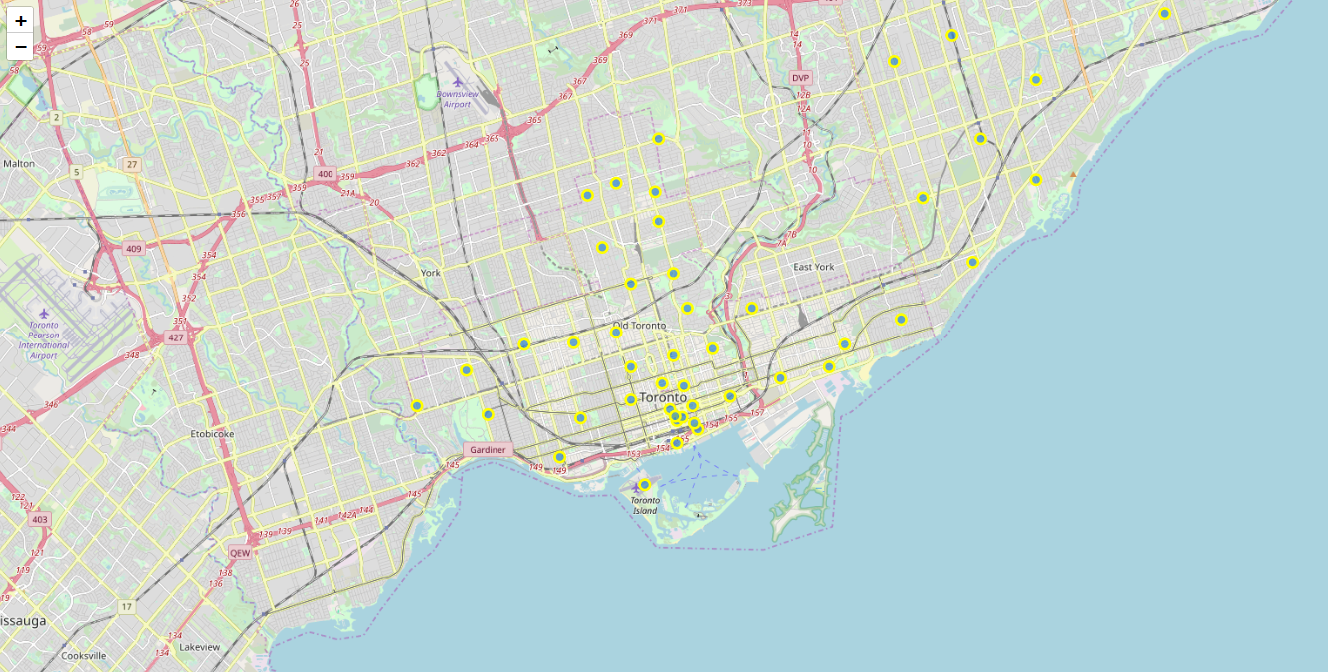
55 neighborhoods were found during the process of gaining city segmentation, and a map of Toronto and Scarborough

Slide 6

3 neighborhoods were selected since they have Chinese restaurants as one of their top venues
M1K | Scarborough | East Birchmount Park, Ionview, Kennedy Park
M1P | Scarborough | Dorset Park, Scarborough Town Centre, Wexford Heights
M1W | Scarborough | L'Amoreaux West, Steeles West

Slide 7
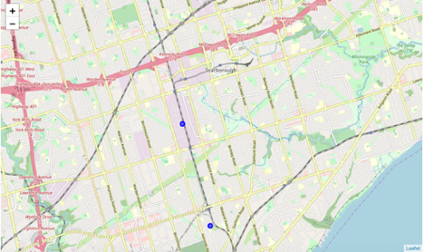
The selected two neighborhoods were quite similar, and they were not far from each other, therefore, this neighborhood that they locate on could be considering as the preferred area for investment.

Slide 8
Results
The two districts, i.e. ‘Dorset Park, Scarborough Town Centre, Wexford heights’, and “L’Amoreaux West, Steels West” can be selected in terms of Restaurants and Grocery Stores. Moreover, they both locate in with the cluster 2, which is Scarborough, and can be considered as the ideal place meeting the requirements of John.

Slide 9
Discussion
As mentioned above, the selected two neighborhoods were quite similar, and they were not far from each other, therefore, this neighborhood that they locate on could be considering as the preferred area for investment.
And the limitations of this analysis include the possible neglect of of neighbors with more Chinese grocery stores and restaurants since it considered more frequency than the amount.
Lastly, the transport factor was not considered in the investment plan, which can be very important in reality. The adoption of 10km parameter of search venues may lead to long distance of traveling and cause inconvenience for tenants.

Slide 10

Conclusion
In this project, we first identified the business problem, which was followed by the data acquisition and preparation. As for machine learning , we utilized K-means clustering and Foursquare API. To conclude, “Dorset Park, Scarborough Town Centre, Wexford heights”, “L’Amoreaux West, Steels West” meets the requirement of our client but better choices may exist. The finding of this project can also help the relevant investors with similar requirements.

